Slide 1
COM1013
INTRODUCTION TO COMPUTER SCIENCE
Lecturer: Begüm MUTLU BİLGE, PhD
begummutlubilge+com1013@gmail.com (recommended)
bmbilge@ankara.edu.tr

Slide 2


Slide 3
Data Abstractions
The data structures supported by a programming language are known as primitive structures.
We will today explore techniques by which data structures other than a language’s primitive structures
Notes:
We learned that the data structures supported by a programming language are known as primitive structures.
In this chapter we will explore techniques by which data structures other than a language’s primitive structures can be constructed and manipulated
An underlying theme throughout this progression is the construction of abstract tools

Slide 4
Basic Data Structures
Arrays
Aggregates
Lists
Stacks
Queues
Trees

Slide 5
Implementing Data Structures
Goal:
to understand how programs that deal with such structures are translated into machine-language programs that manipulate data stored in main memory
Notes:
Let us now consider ways in which the data structures discussed in the previous section can be stored in a computer’s main memory. Our goal here is to understand how programs that deal with such structures are translated into machine-language programs that manipulate data stored in main memory.

Slide 6
Arrays & Aggregates
Array is a “rectangular” block of data whose entries are of the same type.
The simplest form of array is the one-dimensional array, a single row of elements with each position identified by an index.
A two-dimensional array consists of multiple rows and columns in which positions are identified by pairs of indices
the first index identifies the row associated with the position,
the second index identifies the column.

Slide 7
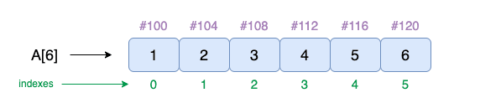
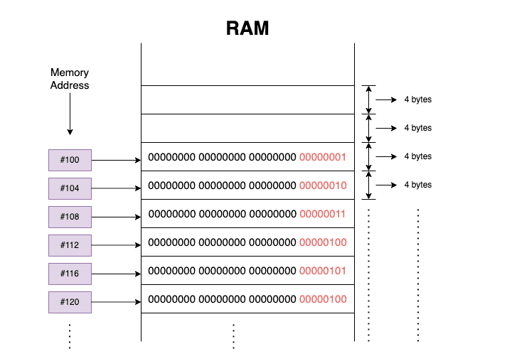
Arrays & Aggregates
Storing 1D Array

Slide 8
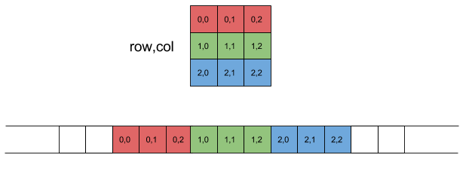
Arrays & Aggregates
Storing 2D Array (2D row-major)
Given a row index i_{row} and a column index i_{col}, the offset of the element they denote in the linear representation is: offset = i_{row}*n_{COLS} + i_{col}
n_{COLS}: the number of columns per row in the matrix.
Notes:
https://eli.thegreenplace.net/2015/memory-layout-of-multi-dimensional-arrays

Slide 9
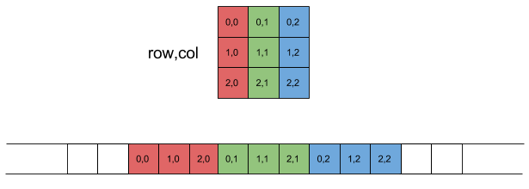
Arrays & Aggregates
Storing 2D Array (2D column-major)
Given a row index i_{row} and a column index i_{col}, the offset of the element they denote in the linear representation is: offset = i_{row} + i_{col} * n_{ROWS}
n_{ROWS}: the number of rows per column in the matrix.
Notes:
https://eli.thegreenplace.net/2015/memory-layout-of-multi-dimensional-arrays

Slide 10
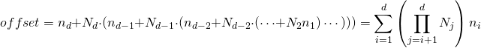
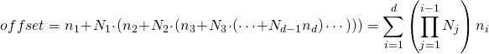
Arrays & Aggregates
Storing Multi dimensional Arrays [Beyond 2D]
In row-major layout of multi-dimensional arrays, the last index is the fastest changing.
In column-major layout of multi-dimensional arrays, the first index is the fastest changing.

Slide 11
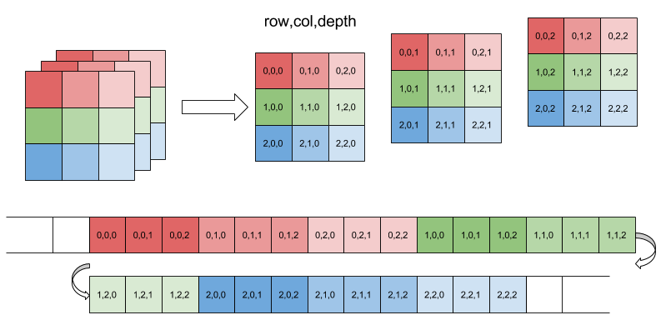
Arrays & Aggregates
Storing 3D Array: rows, columns and depth.
The memory layout of a 3D array with N₁=N₂=N₃=3, in row-major:
Notes:
For example, the offset of the element with indices 2,1,1 is 22.
n1:2 n2: 1 n3:1
1+ 3(1+3*2) = 22

Slide 12
Arrays & Aggregates
An aggregate type is a block of data items that might be of different types and sizes
Example: The block of data relating to a single employee,
the fields of which might be the employee’s name (an array of type character), age (of type integer), and skill rating (of type float).
Fields in an aggregate type are usually accessed by field name, rather than by a numerical index number.
Notes:
In contrast to an array, recall that an aggregate type is a block of data items that might be of different types and sizes.
The items within the block are usually called fields.
An example of an aggregate type would be the block of data relating to a single employee, the fields of which might be the employee’s name (an array
of type character), age (of type integer), and skill rating (of type float).
Fields in an aggregate type are usually accessed by field name, rather than by a numerical index number.

Slide 13
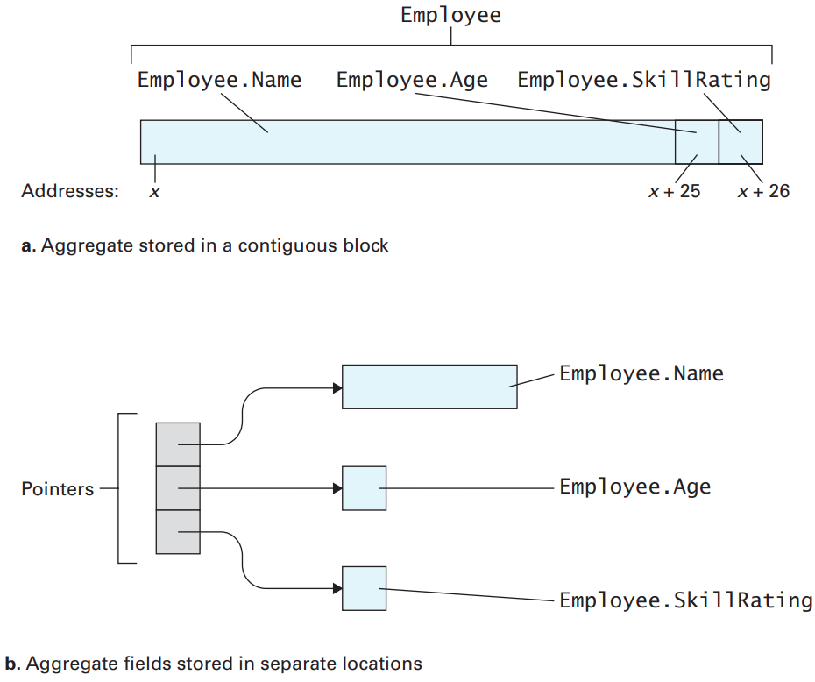
Arrays & Aggregates
Storing Aggregates
Notes:
Now suppose we want to store an aggregate called Employee consisting of the three fields: Name of type character array, Age of type integer, and SkillRating of type float. If the number of memory cells required by each field is fixed, then we can store the aggregate in a block of contiguous cells. For example, suppose the field Name required at most 25 cells, Age required only one cell, and SkillRating required only one cell. Then, we could set aside a block of 27 contiguous cells, store the name in the first 25 cells, store the age in the 26th cell, and store the skill rating in the last cell
With this arrangement, it would be easy to access the different fields within the aggregate. A reference to a field can be translated to a memory cell by knowing the address where the aggregate begins, and the offset of the desired field within that aggregate. If the address of the first cell were x, then any reference to Employee.Name (meaning the Name field within the aggregate Employee) would translate to the 25 cells starting at address x and a reference to Employee.Age (the Age field within Employee) would translate to the cell at address x + 25. In particular, if a translator found a statement such as Employee.Age = 22; in a high-level program, then it would merely build the machine language instructions required to place the value 22 in the memory cell whose address is x + 25
An alternative to storing an aggregate in a block of contiguous memory cells is to store each field in a separate location and then link them together by means of pointers. More precisely, if the aggregate contains three fields, then we find a place in memory to store three pointers, each of which points to one of the fields (Figure 8.7b). If these pointers are stored in a block starting at address x, then the first field can be found by following the pointer stored at location x, the second field can be found by following the pointer at location x + 1, and so forth. This arrangement is especially useful in those cases in which the size of the aggregate’s fields is dynamic. For instance, by using the pointer system the size of the first field can be increased merely by finding an area in memory to hold the larger field and then adjusting the appropriate pointer to point to the new location. But if the aggregate were stored in a contiguous block, the entire structure would have to be altered.

Slide 14
Lists, Stacks, and Queues
Lists: a collection whose entries are arranged sequentially
The beginning of a list is called the head of the list.
The other end of a list is called the tail
Almost any collection of data can be envisioned as a list.
Text can be envisioned as a list of symbols,
A two-dimensional array can be envisioned as a list of rows, and
Music recorded on a CD can be envisioned as a list of sounds.
Notes:
In some cases we may need to remove entries from a list, add new entries to a list,
“process” the entries in a list one at a time, change the arrangement of the entries
in a list, or perhaps search to see if a particular item is in a list

Slide 15
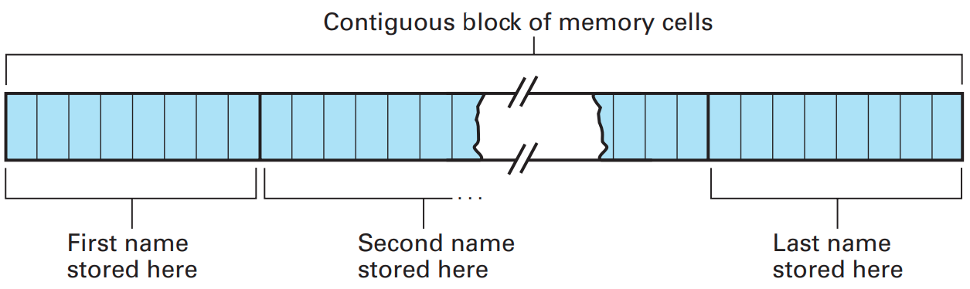
Lists, Stacks, and Queues
Storing Lists: CONTIGUOUS LIST
Names stored in memory as a contiguous list
Notes:
Let us now consider techniques for storing a list of names in a computer’s main memory. One strategy is to store the entire list in a single block of memory cells with consecutive addresses. Assuming that each name is no longer than eight letters, we can divide the large block of cells into a collection of subblocks, each containing eight cells. Into each subblock we can store a name by recording its ASCII code using one cell per letter. If the name alone does not fill all the cells in the subblock allocated to it, we can merely fill the remaining cells with the ASCII code for a space. Using this system requires a block of 80 consecutive memory cells to store a list of 10 names. The storage system just described is summarized in Figure 8.8. The significant point is that the entire list is stored in one large block of memory, with successive entries following each other in contiguous memory cells. Such an organization is referred to as a contiguous list. A contiguous list is a convenient storage structure for implementing static lists, but it has disadvantages in the case of dynamic lists where the deletion and insertion of names can lead to a time-consuming shuffling of entries. In a worst-case scenario, the addition of entries could create the need to move the entire list to a new location to obtain an available block of cells large enough for the expanded list. These problems can be simplified if we allow the individual entries in a list to be stored in different areas of memory rather than together in one large, contiguous block.

Slide 16
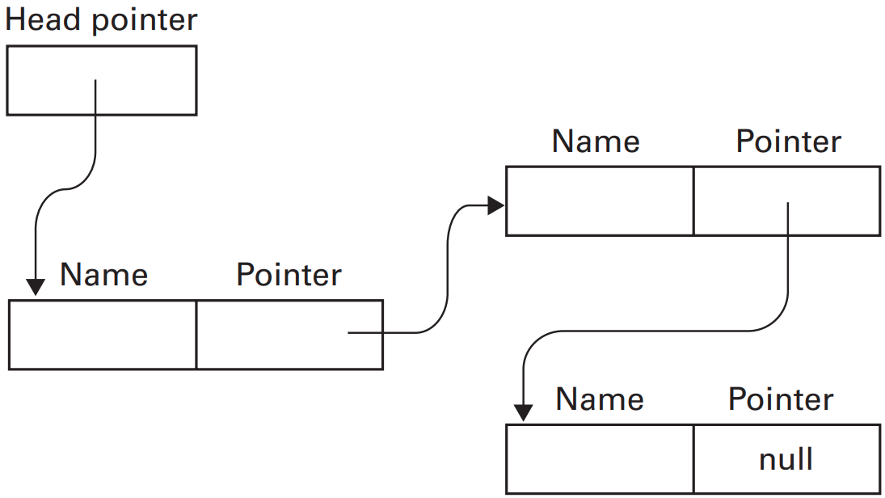
Lists, Stacks, and Queues
Storing Lists: LINK LIST
The structure of a linked list
Notes:
To explain, let us reconsider our example of storing a list of names (where each name is no more than eight characters long). This time we store each name in a block of nine contiguous memory cells. The first eight of these cells are used to hold the name itself, and the last cell is used as a pointer to the next name in the list. Following this lead, the list can be scattered among several small nine-cell blocks linked together by pointers.
Because of this linkage system, such an organization is called a linked list.
To keep track of the beginning of a linked list, we set aside another pointer in which we save the address of the first entry. Since this pointer points to the beginning, or head, of the list, it is called the head pointer. To mark the end of a linked list, we use a null pointer (also known as a NIL pointer in some languages, or the None object in Python), which is merely a special bit pattern placed in the pointer cell of the last entry to indicate that no further entries are in the list. For example, if we agree never to store a list entry at address 0, the value zero will never appear as a legitimate pointer value and can therefore be used as the null pointer. The final linked list structure is represented by the diagram in Figure 8.9, in which we depict the scattered blocks of memory used for the list by individual rectangles. Each rectangle is labeled to indicate its composition. Each pointer is represented by an arrow that leads from the pointer itself to the pointer’s addressee. Traversing the list involves following the head pointer to find the first entry. From there, we follow the pointers stored with the entries to hop from one entry to the next until the null pointer is reached.

Slide 17
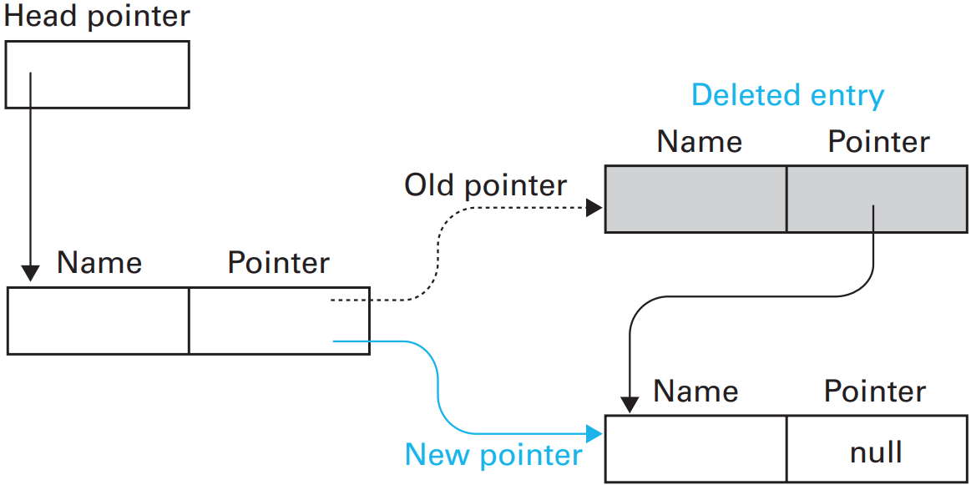
Lists, Stacks, and Queues
To appreciate the advantages of a linked list over a contiguous one, consider the task of deleting an entry
Notes:
To appreciate the advantages of a linked list over a contiguous one, consider
the task of deleting an entry. In a contiguous list this would create a hole, meaning that those entries following the deleted one would have to be moved forward to keep the list contiguous. However, in the case of a linked list, an entry can be
deleted by changing a single pointer. This is done by changing the pointer that
formerly pointed to the deleted entry so that it points to the entry following the
deleted entry (Figure 8.10). From then on, when the list is traversed, the deleted
entry is passed by because it no longer is part of the chain.

Slide 18
Lists, Stacks, and Queues
To appreciate the advantages of a linked list over a contiguous one, consider the task of inserting an entry
Notes:
Inserting a new entry in a linked list is only a little more involved. We first
find an unused block of memory cells large enough to hold the new entry and a
pointer. Here we store the new entry and fill in the pointer with the address of the
entry in the list that should follow the new entry. Finally, we change the pointer
associated with the entry that should precede the new entry so that it points to the new entry (Figure 8.11). After we make this change, the new entry will be found in the proper place each time the list is traversed.

Slide 19
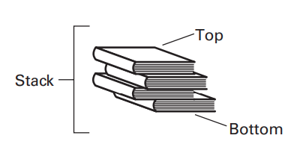
Lists, Stacks, and Queues
Stack: A list in which entries are inserted and removed only at the head.
Last in First Out (LIFO)
An example is a stack of books where physical restrictions dictate that all additions and deletions occur at the top
Notes:
the head of a stack is called the
top of the stack. The tail of a stack is called its bottom or base. Inserting a new
entry at the top of a stack is called pushing an entry. Removing an entry from
the top of a stack is called popping an entry. Note that the last entry placed on a
stack will always be the first entry removed—an observation that leads to a stack
being known as a last-in, first-out, or LIFO structure.
This LIFO characteristic means that a stack is ideal for storing items that must be retrieved in the reverse order from which they were stored, and thus a stack is often used as the underpinning of backtracking activities. (The term backtracking refers to the process of backing out of a system in the opposite order from which the system was entered. A classic example is the process of retracing one’s steps in order to find one’s way out of a forest.) For instance, consider the underlying structure required to support a recursive process. As each new activation is started, the previous activation must be set aside. Moreover, as each activation is completed, the last activation that was set aside must be retrieved. Thus, if the activations are pushed on a stack as they are set aside, then the proper activation will be on the top of the stack each time an activation needs to be retrieved

Slide 20
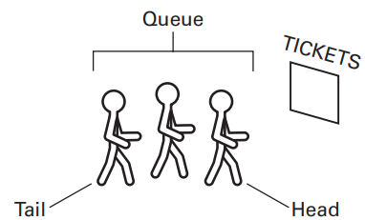
Lists, Stacks, and Queues
Queues: A list in which the entries are removed only at the head and new entries are inserted only at the tail.
First in First Out (FIFO)
An example is a line, or queue, of people waiting to buy tickets at a theater
the person at the head of the queue is served while new arrivals step to the tail of the queue.
Notes:
Queues are often used as the underlying structure of a buffer, introduced in Chapter 1,which is a storage area for the temporary placement of data being transferred from one location to another. As the items of data arrive at the buffer, they are placed at the tail of the queue. Then, when it comes time to forward items to their final destination, they are forwarded in the order in which they appear at the head of the queue. Thus, items are forwarded in the same order in which they arrived.

Slide 21
Lists, Stacks, and Queues
Storing Stack and Queue
An organization similar to a contiguous list is often used
In the case of a stack,
a block of memory, large enough to accommodate the stack at its maximum size, is reserved. (Critical design decision)
One end of this block is designated as the stack’s base.
It is here that the first entry to be pushed onto the stack is stored.
Then each additional entry is placed next to its predecessor as the stack grows toward the other end of the reserved block.
Notes:
For storing stacks and queues, an organization similar to a contiguous list is often used.
In the case of a stack, a block of memory, large enough to accommodate the stack at its maximum size, is reserved. (Critical design decision)
One end of this block is designated as the stack’s base.
It is here that the first entry to be pushed onto the stack is stored.
Then each additional entry is placed next to its predecessor as the stack grows toward the other end of the reserved block.

Slide 22
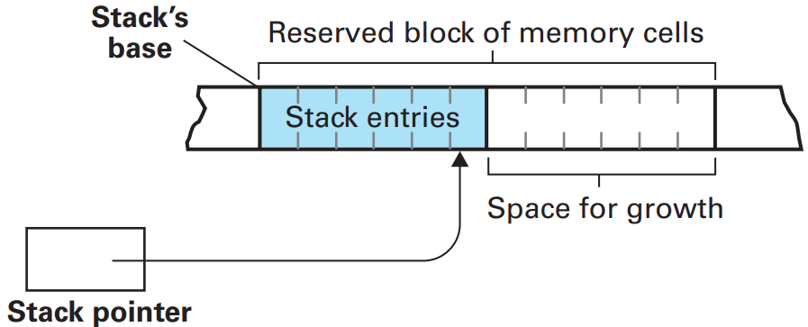
Lists, Stacks, and Queues
Storing Stack
As entries are pushed and popped, the location of the top of the stack will move back and forth
To keep track of this location, its address is stored in an additional memory cell, stack pointer.
a pointer to the top of the stack.
Notes:
The complete system, as illustrated in Figure 8.12, works as follows: To push a new entry on the stack, we first adjust the stack pointer to point to the vacancy just beyond the top of the stack and then place the new entry at this location. To pop an entry from the stack, we read the data pointed to by the stack pointer and then adjust the stack pointer to point to the next entry down on the stack.

Slide 23
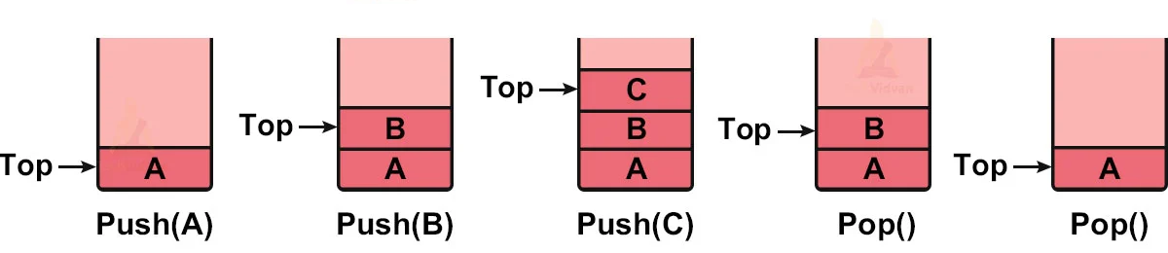
Lists, Stacks, and Queues
Storing Stack [Example]

Slide 24
Lists, Stacks, and Queues
Storing Queue
Reserve a block of contiguous cells in main memory large enough to hold the queue at its projected maximum size.
in the case of a queue we need to perform operations at both ends of the structure
so we set aside two memory cells to use as pointers
head pointer, keeps track of the head of the queue
tail pointer, keeps track of the tail
Notes:
The traditional implementation of a queue is similar to that of a stack.
Again we reserve a block of contiguous cells in main memory large enough to hold the queue at its projected maximum size.
However, in the case of a queue we need to perform operations at both ends of the structure, so we set aside two memory
cells to use as pointers instead of only one as we did for a stack.
One of these pointers, called the head pointer, keeps track of the head of the queue; the other, called the tail pointer, keeps track of the tail.

Slide 25
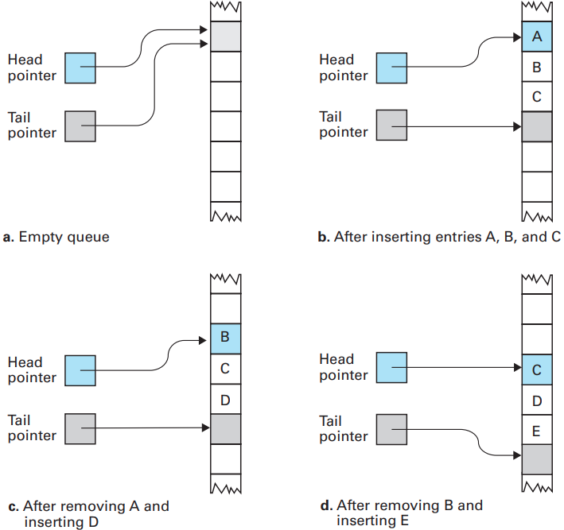
Lists, Stacks, and Queues
Storing Queue
Notes:
When the queue is empty, both of these pointers point to the same location (Figure 8.13). Each time an entry is inserted into the queue, it is placed in the location pointed to by the tail pointer, and then the tail pointer is adjusted to point to the next unused location. In this manner, the tail pointer is always pointing to the first vacancy at the tail of the queue. Removing an entry from the queue involves extracting the entry pointed to by the head pointer and then adjusting the head pointer to point to the next entry in the queue.

Slide 26
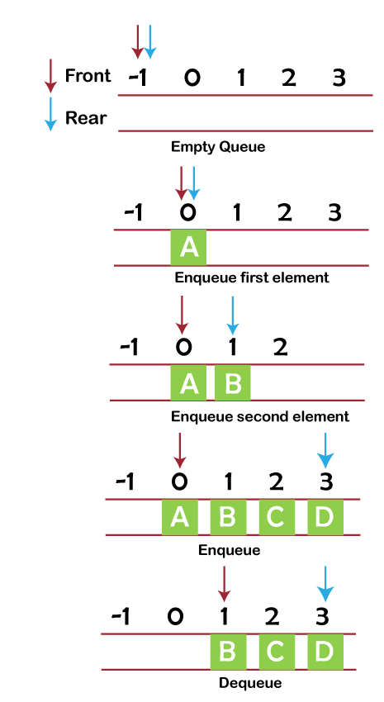
Lists, Stacks, and Queues
Queue

Slide 27
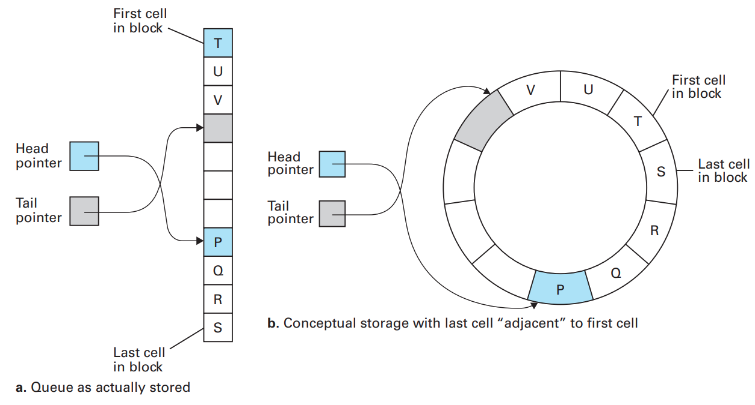
Lists, Stacks, and Queues
Storing Queue: circular queue
Notes:
A problem with the storage system as described thus far is that, as entries are
inserted and removed, the queue crawls through memory like a glacier (see again
Figure 8.13). Thus we need a mechanism for confining the queue to its reserved
block of memory. The solution is simple. We let the queue migrate through the
block. Then, when the tail of the queue reaches the end of the block, we start
inserting additional entries back at the original end of the block, which by this
time is vacant. Likewise, when the last entry in the block finally becomes the
head of the queue and this entry is removed, the head pointer is adjusted back to
the beginning of the block where other entries are, by this time, waiting. In this
manner, the queue chases itself around within the block as though the ends of the block were connected to form a loop (Figure 8.14). The result is an implementation called a circular queue.

Slide 28
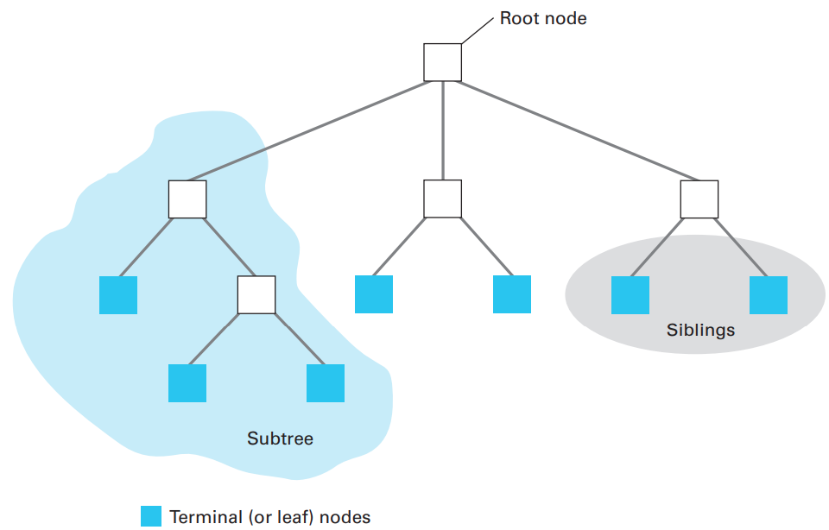
Trees
A tree is a collection whose entries have a hierarchical organization
Notes:
Each position in a tree is called a node (Figure 8.3). The node at the top is called the root node (if we turned the drawing upside down, this node would represent the base or root of the tree). The nodes at the other extreme are called terminal nodes (or sometimes leaf nodes). We often refer to the number of nodes in the longest path from the root to a leaf as the depth of the tree. In other words, the depth of a tree is the number of horizontal layers within it.
At times we refer to tree structures as though each node gives birth to those nodes immediately below it. In this sense, we often speak of a node’s ancestors or descendants. We refer to its immediate descendants as its children and its immediate ancestor as its parent. Moreover, we speak of nodes with the same parent as being siblings. A tree in which each parent has no more than two children is called a binary tree. If we select any node in a tree, we find that that node together with the nodes below it also have the structure of a tree. We call these smaller structures subtrees. Thus, each child node is the root of a subtree below the child’s parent. Each such subtree is called a branch from the parent. In a binary tree, we often speak of a node’s left branch or right branch in reference to the way the tree is displayed.

Slide 29
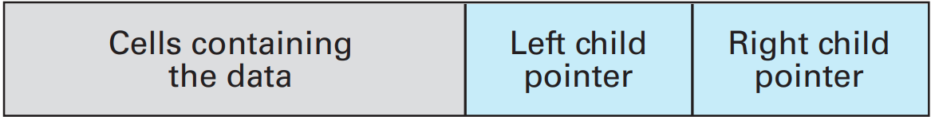
Storing Binary Trees
Trees in which each node has at most two children
Stored in memory using a linked structure similar to that of linked lists.
Each entry (or node) of the binary tree contains:
the data,
a pointer to the node’s first child, and
a pointer to the node’s second child.
Notes:
For the purpose of discussing tree storage techniques, we restrict our attention to binary trees, which we recall are trees in which each node has at most two children.
Such trees normally are stored in memory using a linked structure similar to that of linked lists.
However, rather than each entry consisting of two components (the data followed by a next-entry pointer), each entry (or node) of the binary tree contains three components: (1) the data, (2) a pointer to the node’s first child, and (3) a pointer to the node’s second child.
Although there is no left or right inside a machine, it is helpful to refer to the first pointer as the left child pointer and the other pointer as the right child pointer in reference to the way we would draw the tree on paper.
Thus each node of the tree is represented by a short, contiguous block of memory cells with the format shown in Figure 8.15.

Slide 30
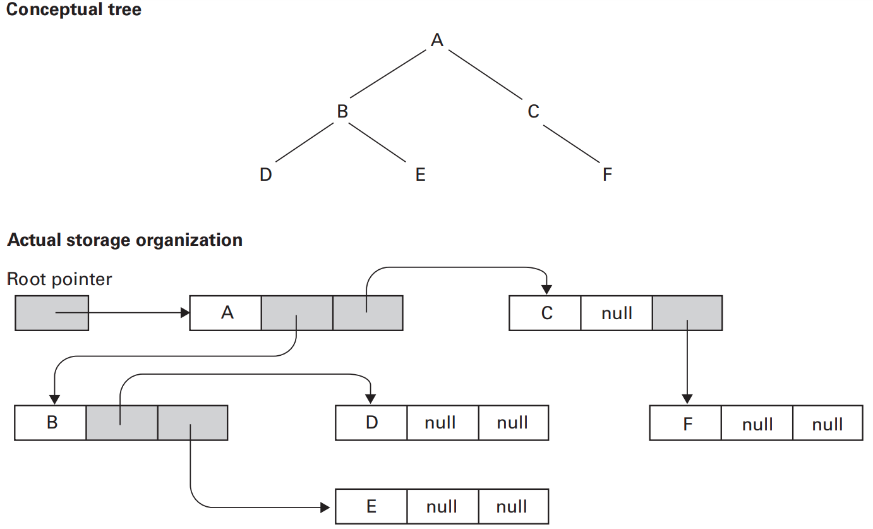
Storing Binary Trees
Notes:
Storing the tree in memory involves finding available blocks of memory cells
to hold the nodes and linking these nodes according to the desired tree structure.
Each pointer must be set to point to the left or right child of the pertinent node
or assigned the null value if there are no more nodes in that direction of the tree.
(This means that a terminal node is characterized by having both of its pointers
assigned null.) Finally, we set aside a special memory location, called a root
pointer, where we store the address of the root node. It is this root pointer that
provides initial access to the tree.
An example of this linked storage system is presented in Figure 8.16, where a
conceptual binary tree structure is exhibited along with a representation of how
that tree might actually appear in a computer’s memory. Note that the actual
arrangement of the nodes within main memory might be quite different from the
conceptual arrangement. However, by following the root pointer, one can find
the root node and then trace any path down the tree by following the appropriate
pointers from node to node.

Slide 31
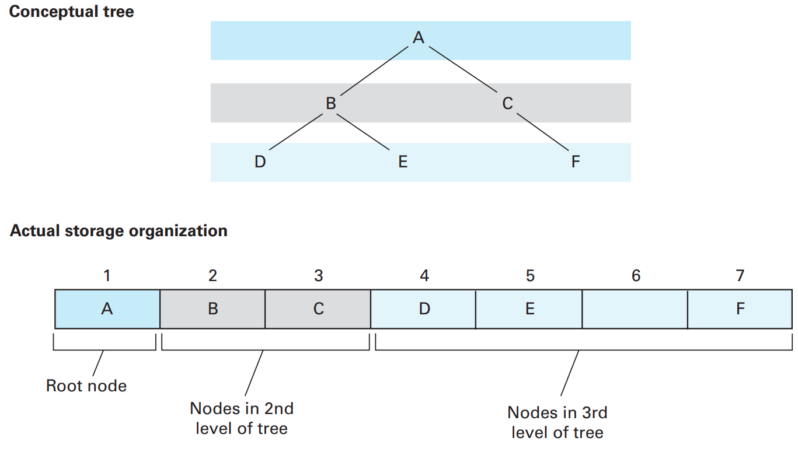
Storing Binary Trees
Another approach: Using contiguous block of memory
Notes:
An alternative to storing a binary tree as a linked structure is to use a single, contiguous block of memory cells for the entire tree. Using this approach, we store the tree’s root node in the first cell of the block.
(For simplicity, we assume that each node of the tree requires only one memory cell.) Then we store the left child of the root in the second cell, store the right child of the root in the third cell, and in general, continue to store the left and right children of the node found in cell n in the cells 2n and 2n + 1, respectively.
Cells within the block that represent locations not used by the tree are marked with a unique bit pattern that indicates the absence of data.
Using this technique, the same tree shown in Figure 8.16 would be stored as shown in Figure 8.17. Note that the system is essentially that of storing the nodes across successively lower levels of the tree as segments, one after the other. That is, the first entry in the block is the root node, followed by the root’s children, followed by the root’s grandchildren, and so on.
In contrast to the linked structure described earlier, this alternative storage system provides an efficient method for finding the parent or sibling of any node. The location of a node’s parent can be found by dividing the node’s position in the block by 2 while discarding any remainder (the parent of the node in position 7 would be the node in position 3). The location of a node’s sibling can be found by adding 1 to the location of a node in an even-numbered position or subtracting 1 from the location of a node in an odd-numbered position. For example, the sibling of the node in position 4 is the node in position 5, while the sibling of the node in position 3 is the node in position 2.

Slide 32
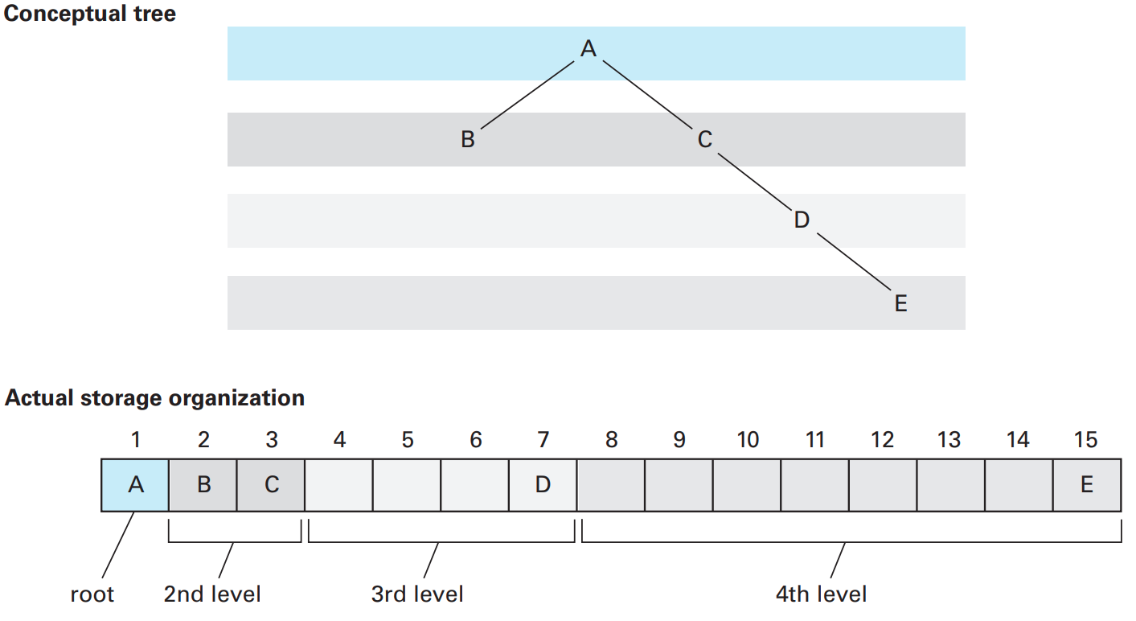
Storing Binary Trees
A sparse, unbalanced tree shown in its conceptual form and as it would be stored without pointers
Notes:
this storage system makes efficient use of space when the binary tree is approximately balanced (in the sense that both subtrees below the root node have the same depth) and full (in the sense that it does not have long, thin branches). For trees without these characteristics, though, the system can become quite inefficient, as shown in Figure 8.18

Slide 33
Abstraction Again
The structures are often associated with data.
However, a computer’s main memory is not organized as arrays, lists, stacks, queues, and trees but
is instead organized as a sequence of addressable memory cells.
Thus, all other structures must be simulated.
How this simulation is accomplished is the subject of today’s lecture.
Notes:
The structures presented in the previous section are often associated with data.
However, a computer’s main memory is not organized as arrays, lists, stacks, queues, and trees but is instead organized as a sequence of addressable memory cells.
Thus, all other structures must be simulated.
How this simulation is accomplished is the subject of this chapter.
For now we merely point out that organizations such as arrays, lists, stacks, queues, and trees are abstract tools that are created so that users of the data can be shielded from the details of actual data storage and can be allowed to access information as though it were stored in a more convenient form. The term user in this context does not necessarily refer to a human. Instead, the meaning of the word depends on our perspective at the time. If we are thinking in terms of a person using a PC to maintain bowling league records, then the user is a human. In this case, the application software (perhaps a spreadsheet software package) would be responsible for presenting the data in an abstract form convenient to the human—most likely as an array. If we are thinking in terms of a server on the Internet, then the user might be a client. In this case, the server would be responsible for presenting data in an abstract form convenient to the client. If we are thinking in terms of the modular structure of a program, then the user would be any module requiring access to the data. In this case, the module containing the data would be responsible for presenting the data in an abstract form convenient to the other modules. In each of these scenarios, the common thread is that the user has the privilege of accessing data as an abstract tool.

Slide 34
Static Versus Dynamic Structures
An important distinction in constructing abstract data structures is whether the structure being simulated is static or dynamic,
whether the shape or size of the structure changes over time.
A general rule: static structures are more easily managed than dynamic ones.
Notes:
An important distinction in constructing abstract data structures is whether the structure being simulated is static or dynamic, that is, whether the shape or size of the structure changes over time.
For example, if the abstract tool is a list of names, it is important to consider whether the list will remain a fixed size throughout its existence or expand and shrink as names are added and deleted.
As a general rule, static structures are more easily managed than dynamic ones.
If a structure is static, we need merely to provide a means of accessing the various data items in the structure and perhaps a means of changing the values at designated locations.
But, if the structure is dynamic, we must also deal with the problems of adding and deleting entries as well as finding the memory space required by a growing data structure.
In the case of a poorly designed structure, adding a single new entry could result in a massive rearrangement of the structure, and excessive growth could dictate that the entire structure be transferred to another memory area where more space is available.

Slide 35
Pointers
In the case of data structures, pointers are used to record the location where data items are stored.
Recap: A register called a program counter
is used to hold the address of the next instruction to be executed.
Thus, the program counter plays the role of a pointer.
In fact, another name for a program counter is instruction pointer.
Notes:
Recall that the various cells in a machine’s main memory are identified by numeric addresses.
Being numeric values, these addresses themselves can be encoded and stored in memory cells.
A pointer is a storage area that contains such an encoded address.
In the case of data structures, pointers are used to record the location where data items are stored.
For example, if we must repeatedly move an item of data from one location to another, we might designate a fixed location to serve as a pointer. Then, each time we move the item, we can update the pointer to reflect the new address of the data. Later, when we need to access the item of data, we can find it by means of the pointer.
Indeed, the pointer will always “point” to the data.
There we found that a register called a program counter is used to hold the address of the next instruction to be executed. Thus, the program counter plays the role of a pointer. In fact, another name for a program counter is instruction pointer.

Slide 36
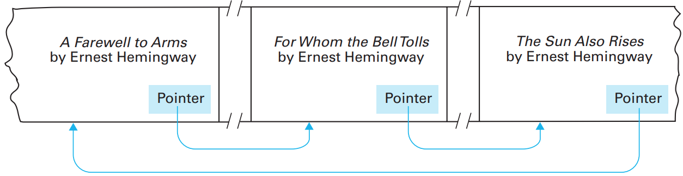
Pointers
Novels arranged by title but linked according to authorship
Notes:
As an example of the application of pointers, suppose we have a list of novels
stored in a computer’s memory alphabetically by title. Although convenient in
many applications, this arrangement makes it difficult to find all the novels by a
particular author—they are scattered throughout the list. To solve this problem,
we can reserve an additional memory cell within each block of cells representing
a novel and use this cell as a pointer to another block representing a book by the
same author. In this manner the novels with common authorship can be linked
in a loop (Figure 8.4). Once we find one novel by a given author, we can find all
the others by following the pointers from one book to another.
Many modern programming languages include pointers as a primitive data
type. That is, they allow the declaration, allocation, and manipulation of pointers
in ways reminiscent of integers and character strings. Using such a language, a
programmer can design elaborate networks of data within a machine’s memory
where pointers are used to link related items to each other.

Slide 37

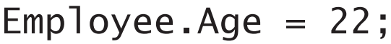
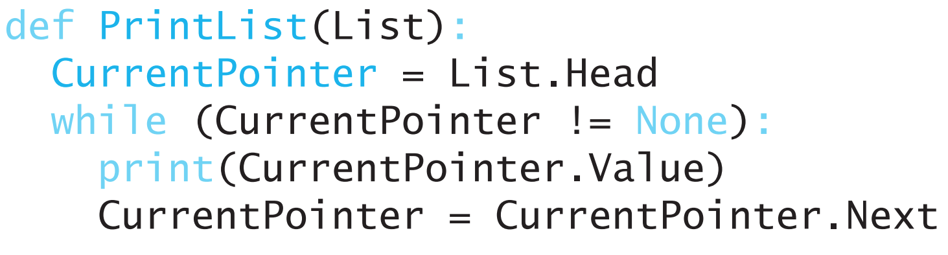
Manipulating Data Structures
Notes:
We have seen that the way data structures are actually stored in a computer’s memory is not the same as the conceptual structure envisioned by the user. A two-dimensional array is not actually stored as a two-dimensional rectangular block, and a list or a tree might actually consist of small pieces scattered over a large area of memory. Hence, to allow the user to access the structure as an abstract tool, we must shield the user from the complexities of the actual storage system. This means that instructions given by the user (and stated in terms of the abstract tool) must be converted into steps that are appropriate for the actual storage system. In the case of arrays, we have seen how this can be done by using an address polynomial to convert row and column indices into memory cell addresses. In particular, we have seen how the statement Sales[3, 4] = 5; written by a programmer who is thinking in terms of an abstract array can be converted into steps that perform the correct modifications to main memory. Likewise, we have seen how statements such as Employee.Age = 22; referring to an abstract aggregate type can be translated into appropriate actions depending on how the aggregate is actually stored. In the case of lists, stacks, queues, and trees, instructions stated in terms of the abstract structure are usually converted into the appropriate actions by means of functions that perform the required task while shielding the user from the details of the underlying storage system. For example, if the function insert were provided for inserting new entries into a linked list, then J. W. Brown could be inserted in the list of students enrolled in Physics 208 merely by executing a function call such as insert("Brown, J.W.", Physics208) Note that the function call is stated entirely in terms of the abstract structure—the manner in which the list is actually implemented is hidden. As a more detailed example, Figure 8.19 presents a function named printList for printing a linked list of values. This function assumes that the first entry of the list is pointed to by a field called Head within the aggregate called List, and that each entry in the list consists of two pieces: a value (“Value”) and a pointer to the next entry (“Next”). In the figure, the special Python value None is used as the null pointer. Once this function has been developed, it can be used to print a linked list as an abstract tool without being concerned for the steps actually required to print the list. For example, to obtain a printed class list for Economics 301, a user need only perform the function call printList(Economics301ClassList) to obtain the desired results. Moreover, if we should later decide to change the manner in which the list is actually stored, then only the internal actions of the function printList must be changed—the user would continue to request the printing of the list with the same function call as before.

Slide 38
A Short Case Study
Let us consider the task of storing a list of names in alphabetical order. We assume that the operations to be performed on this list are the following:
search for the presence of an entry,
print the list in alphabetical order, and
insert a new entry
Our goal is to develop a storage system along with a collection of functions to perform these operations—thus producing a complete abstract tool.

Slide 39
A Short Case Study
We begin by considering options for storing the list.
List in a sequential fashion ??
Binary search tree ??
Notes:
We begin by considering options for storing the list. If the list were stored
according to the linked list model, we would need to search the list in a sequential
fashion, a process that, as we discussed in Chapter 5, could be very inefficient
if the list becomes long. We will therefore seek an implementation that allows
us to use the binary search algorithm (Section 5.5) for our search procedure. To
apply this algorithm, our storage system must allow us to find the middle entry
of successively smaller portions of the list. Our solution is to store the list as a
binary tree. We make the middle list entry the root node. Then we make the
middle of the remaining first half of the list the root’s left child, and we make the
middle of the remaining second half the root’s right child. The middle entries of
each remaining fourth of the list become the children of the root’s children and
so forth.

Slide 40
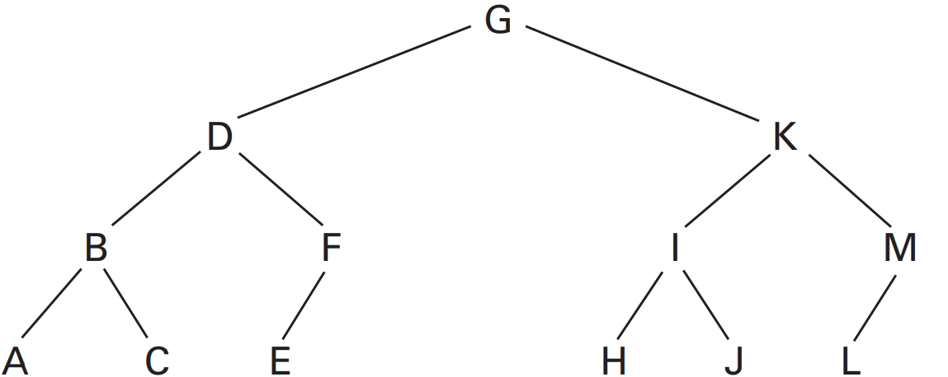
A Short Case Study
The letters A through M arranged in an ordered tree
Notes:
For example, the tree in Figure 8.20 represents the list of letters A, B, C, D, E, F, G, H, I, J, K, L, and M
To search the list stored in this manner, we compare the target value to the root node. If the two are equal, our search has succeeded. If they are not equal, we move to the left or right child of the root, depending on whether the target is less than or greater than the root, respectively. There we find the middle of the portion of the list that is necessary to continue the search. This process of comparing and moving to a child continues until we find the target value (meaning that our search was successful) or we reach a null pointer (None) without finding the target value (meaning that our search was a failure).

Slide 41
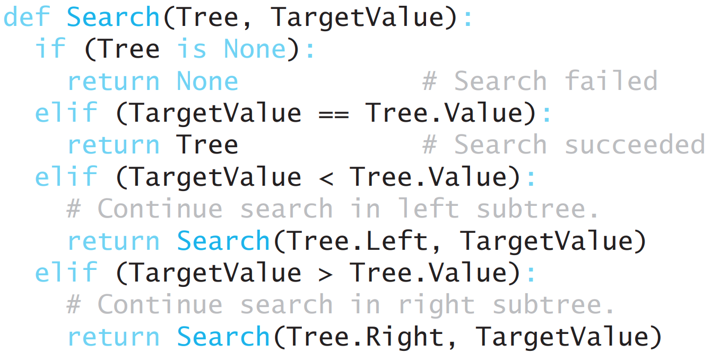
A Short Case Study: Search
The binary search as it would appear if the list were implemented as a linked binary tree
Notes:
Figure 8.21 shows how this search process can be expressed in the case of a
linked tree structure.

Slide 42
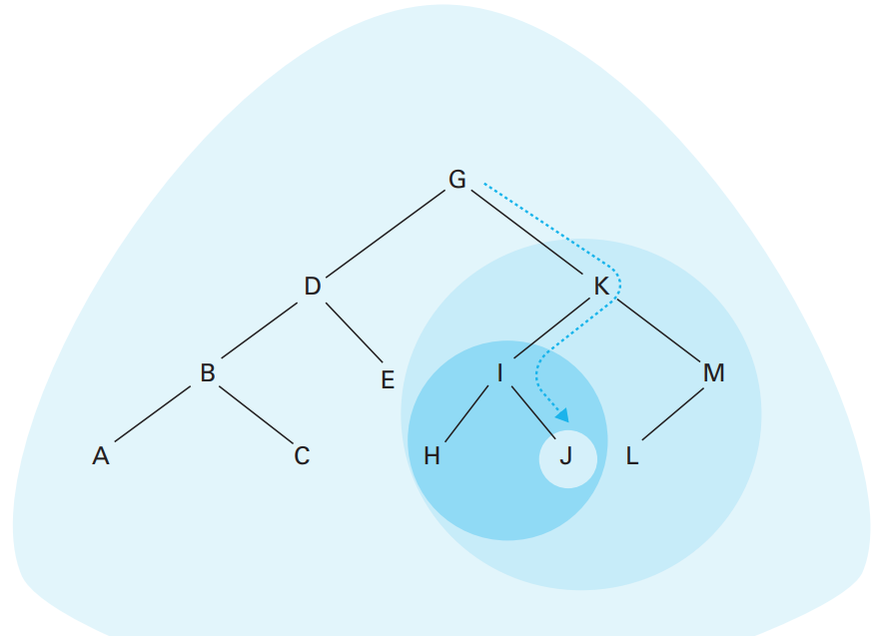
A Short Case Study: Search
The successively smaller trees considered by the function in Figure 8.21 when searching for the letter J

Slide 43
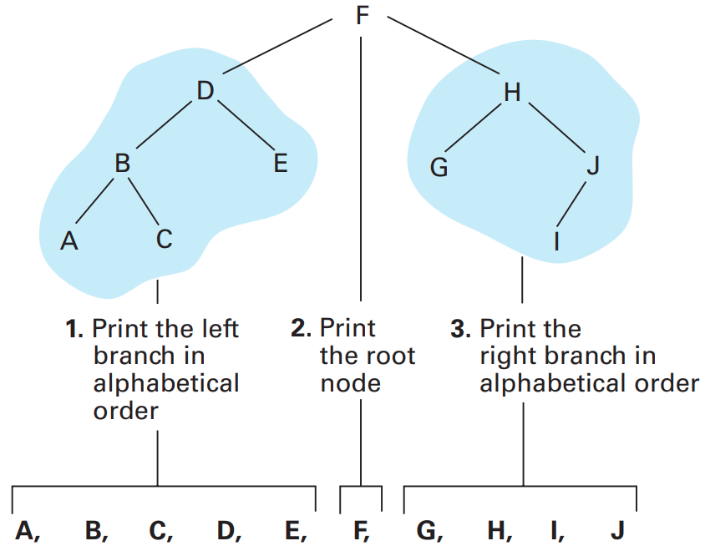
A Short Case Study: Print
Printing a search tree in alphabetical order
Notes:
Having stored our “list” as a binary tree, you might think that the process of
printing the list in alphabetical order would now be difficult. However, to print
the list in alphabetical order, we merely need to print the left subtree in alphabetical order, print the root node, and then print the right subtree in alphabetical order (Figure 8.23). After all, the left subtree contains all the elements that are less than the root node, while the right subtree contains all the elements that are greater than the root.
A sketch of our logic so far looks like this:
if (tree not empty):
print the left subtree in alphabetical order
print the root node
print the right subtree in alphabetical order
This outline involves the tasks of printing the left subtree and the right subtree in alphabetical order, both of which are essentially smaller versions of our original task. That is, solving the problem of printing a tree involves the smaller task of printing subtrees, which suggests a recursive approach to our tree printing problem

Slide 44
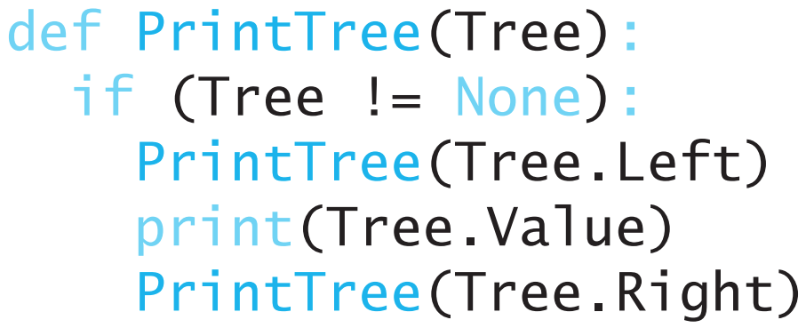
A Short Case Study: Print
A function for printing the data in a binary tree
Notes:
Following this lead, we can expand our initial idea into a complete Python
function for printing our tree as shown in Figure 8.24. We have assigned the
function the name PrintTree and then requested the services of PrintTree for
printing the left and right subtrees. Note that the termination condition of the
recursive process (reaching a null subtree, “None”) is guaranteed to be reached,
because each successive activation of the function operates on a smaller tree than
the one causing the activation.

Slide 45
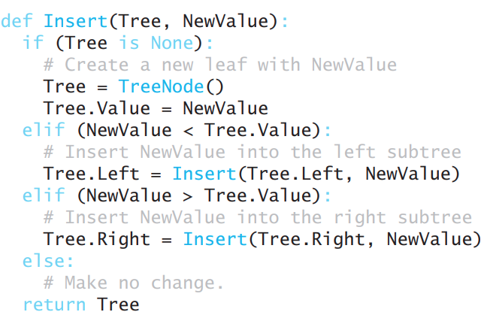
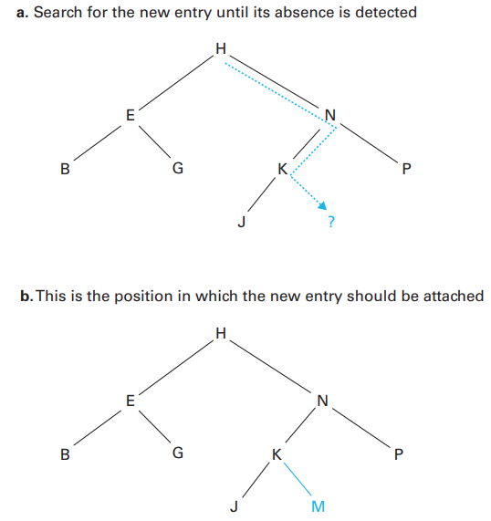
A Short Case Study: Insert
Inserting the entry M into the list B, E, G, H, J, K, N, P stored as a tree
Notes:
The task of inserting a new entry in the tree is also easier than it might appear at first. Your intuition might lead you to believe that insertions might require cutting the tree open to allow room for new entries, but actually the node being added can always be attached as a new leaf, regardless of the value involved. To find the proper place for a new entry, we move down the tree along the path that we would follow if we were searching for that entry. Since the entry is not in the tree, our search will lead to a null pointer. At this point we will have found the proper location for the new node (Figure 8.25). Indeed, this is the location to which a search for the new entry would lead
A function expressing this process in the case of a linked tree structure is shown in Figure 8.26. It searches the tree for the value being inserted (called NewValue) and then places a new leaf node containing NewValue at the proper location. Note that if the entry being inserted is actually found in the tree during the search, no insertion is made. The Python code in Figure 8.26 uses the function call TreeNode() to create a new aggregate to serve as a fresh leaf in the linked tree structure. This requires additional code outside of the figure to identify TreeNode as user-defined type, as we will see in the next section.

Slide 46
A Short Case Study: Conclusion
A software package consisting of a linked binary tree structure together with our functions for searching, printing, and inserting provides a complete package
that could be used as an abstract tool by our hypothetical application.
Indeed, when properly implemented, this package could be used without concern for the actual underlying storage structure.
By using the procedures in the package, the user could envision a list of names stored in alphabetical order,
whereas the reality would be that the “list” entries are actually scattered among blocks of memory cells that are linked as a binary tree.

Slide 47
Customized Data Types
We introduced the concept of a data type and discussed such elementary types as integer, float, character, and Boolean.
These data types are provided in most programming languages as primitive data types.
Now we consider ways in which a programmer can define her/his own data types to fit more closely the needs of a particular application
User-Defined Data Types
Abstract Data Types

Slide 48
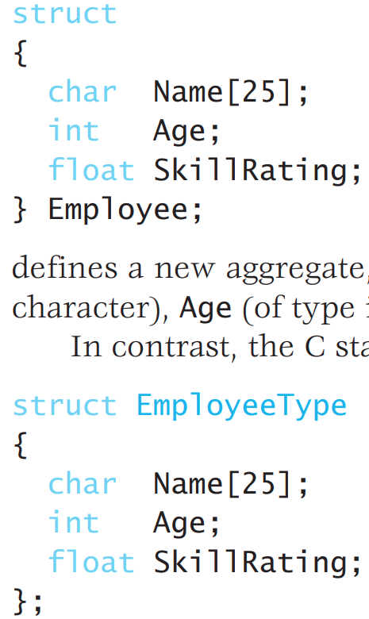
User-Defined Data Types
LEFT: defines a new aggregate, called Employee, containing fields called Name (of type character), Age (of type integer), and SkillRating (of type float).
Notes:
Expressing an algorithm is often easier if data types other than those provided as primitives in the programming language are available.
For this reason, many modern programming languages allow programmers to define additional data types, using the primitive types as building blocks. The most elementary examples of such “home-made” data types are known as user-defined data types, which are essentially conglomerates of primitive types collected under a single name.
To explain, suppose we wanted to develop a program involving numerous variables, each with the same aggregate structure consisting of a name, age, and skill rating. One approach would be to define each variable separately as an aggregate type (Section 6.2). A better approach, however, would be to define the aggregate to be a new (user-defined) data type and then to use that new type as though it were a primitive.
Recalling the example from Section 6.2, in C the statement (LEFT) defines a new aggregate, called Employee, containing fields called Name (of type character), Age (of type integer), and SkillRating (of type float).

Slide 49
User-Defined Data Types
RIGHT: does not define a new aggregate variable, but defines a new aggregate type, EmployeeType.
Notes:
In contrast, the C statement (RIGHT) struct EmployeeType { char Name[25]; int Age; float SkillRating; }; does not define a new aggregate variable, but defines a new aggregate type, EmployeeType.
This new data type could then be used to declare variables in the same way as a primitive data type.
That is, in the same way that C allows the variable x to be declared as an integer using the statement int x;
the variable Employee1 could be declared to be of the type Employee with the statement
struct EmployeeType Employee1;
Then, later in the program, the variable Employee1 would refer to an entire block of memory cells containing the name, age, and skill rating of an employee.
Individual items within the block could be referenced by expressions such as Employee1.Name and Employee1.Age.
Thus, a statement such as
Employee1.Age = 26; might be used to assign the value 26 to the Age field within the block known as Employee1.
Moreover, the statement struct EmployeeType DistManager, SalesRep1, SalesRep2; could be used to declare the three variables DistManager, SalesRep1, and SalesRep2 to be of type EmployeeType
It is important to distinguish between a user-defined data type and an actual item of that type. The latter is referred to as an instance of the type. A userdefined data type is essentially a template that is used in constructing instances of the type. It describes the properties that all instances of that type have but does not itself constitute an occurrence of that type (just as a cookie-cutter is a template from which cookies are made but is not itself a cookie). In the preceding example, the user-defined data type EmployeeType was used to construct three instances of that type, known as DistManager, SalesRep1, and SalesRep2.

Slide 50
Abstract Data Types
Traditional user defined data types, merely allow programmers to define new storage systems.
They do not also provide operations to be performed on data with these structures.
An abstract data type (ADT) is a user-defined data type that can include both data (representation) and functions (behavior)
Notes:
Traditional user defined data types, however, merely allow programmers to define new storage systems. They do not also provide operations to be performed on data with these structures.
An abstract data type (ADT) is a user-defined data type that can include both data (representation) and functions (behavior)

Slide 51
Abstract Data Types
Programming languages that support creation of ADTs generally provide two features:
syntax for defining the ADT as single unit, and
a mechanism for hiding the internal structure of the ADT from other parts of the program that will make use of it.
Notes:
Programming languages that support creation of ADTs generally provide two features: (1) syntax for defining the ADT as single unit, and (2) a mechanism for hiding the internal structure of the ADT from other parts of the program that will make use of it. The first feature is an important organizational tool for keeping the data and functions of an ADT together, which simplifies maintenance and debugging. The second feature provides reliability, by preventing other code outside of the ADT from accessing its data without going through the functions that have been provided for that purpose.

Slide 52
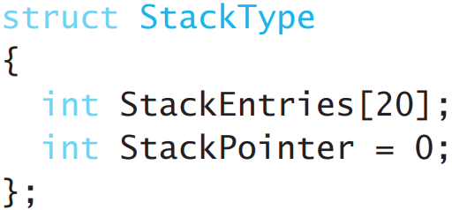
Abstract Data Types
would reference a unique block of memory cells used to implement an individual stack.
But what if we now want to push the value 25 onto StackOne?
Notes:
To clarify, suppose we wanted to create and use several stacks of integer values within a program. Our approach might be to implement each stack as an array of 20 integer values. The bottom entry in the stack would be placed (pushed) into the first array position, and additional stack entries would be placed (pushed) into successively higher entries in the array (see question 7 in Section 8.3). An additional integer variable would be used as the stack pointer. It would hold the index of the array entry into which the next stack entry should be pushed. Thus each stack would consist of an array containing the stack itself and an integer playing the role of the stack pointer. To implement this plan, we could first establish a user-defined type called StackType with a C statement of the form
struct StackType { int StackEntries[20]; int StackPointer = 0; };
Having made this declaration, we could then declare stacks called StackOne, StackTwo, and StackThree via the statement struct StackType StackOne, StackTwo, StackThree;
At this point, each of the variables StackOne, StackTwo, and StackThree would reference a unique block of memory cells used to implement an individual stack. But what if we now want to push the value 25 onto StackOne? perhaps by using a function call similar to
push(25, StackOne);
But such a statement would not be available unless we also defined an appropriate function named push. Other operations we would like to perform on variables of type StackType would include popping entries off the stack, checking to see if the stack is empty, and checking to see if the stack is full—all of which would require definitions of additional functions. In short, our definition of the data type StackType has not included all the properties we would like to have associated with the type. Moreover, any function in the program can potentially access the StackPointer and StackEntries fields of our StackType variables, bypassing the careful checks we would design into our push and pop functions. A sloppy assignment statement in another part of the program could overwrite a data element stored in the middle of the stack data structure, or even destroy the LIFO behavior that is characteristic of all stacks.
What is needed is a mechanism for defining the operations that are allowed on our StackType, as well as for protecting the internal variables from outside interference. One such mechanism is the Java language’s interface syntax. For example, in Java, we could write
interface StackType { public int pop(); /* Return the item at top of stack */ public void push(int item); /* Add a new item to stack */ public boolean isEmpty(); /* Check if stack is emtpy */ public boolean isFull(); /* Check if stack is full */ }
Alone, this abstract data type does not specify how the stack will be stored, or what algorithms will be used to execute the push, pop, isEmpty, and isFull functions. Those details (which have been abstracted away in this interface) will be specified in other Java code elsewhere. However, like our user-defined data type before, programmers are able to declare variables or function parameters to be of type StackType. We could declare
StackOne, StackTwo, and StackThree to be stacks with the statement
StackType StackOne, StackTwo, StackThree;
Later in the program (these three variables start out as null references and must be instantiated with concrete Java classes before use—but we are not concerned with those details here), we could push entries onto these stacks with statements such as StackOne.push(25);
which means to execute the push function associated with StackOne using the value 25 as the actual parameter.
As opposed to the more elementary user-defined data types, abstract data types are complete data types, and their appearance in such languages as Ada in the 1980s represented a significant step forward in programming language design. Today, object-oriented languages provide for extended versions of abstract data types called classes, as we will see in the next section

Slide 53
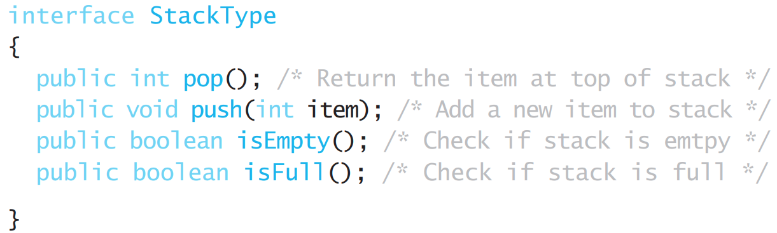
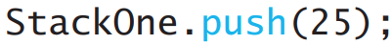
Abstract Data Types
What is needed is a mechanism for defining the operations that are allowed on our StackType, as well as for protecting the internal variables from outside interference.
Notes:
But such a statement would not be available unless we also defined an appropriate function named push.
Other operations we would like to perform on variables of type StackType would include popping entries off the stack, checking to see if the stack is empty, and checking to see if the stack is full—all of which would require definitions of additional functions.
In short, our definition of the data type StackType has not included all the properties we would like to have associated with the type. Moreover, any function in the program can potentially access the StackPointer and StackEntries fields of our StackType variables, bypassing the careful checks we would design into our push and pop functions.
A sloppy assignment statement in another part of the program could overwrite a data element stored in the middle of the stack data structure, or even destroy the LIFO behavior that is characteristic of all stacks.
What is needed is a mechanism for defining the operations that are allowed on our StackType, as well as for protecting the internal variables from outside interference. One such mechanism is the Java language’s interface syntax. For example, in Java, we could write
interface StackType { public int pop(); /* Return the item at top of stack */ public void push(int item); /* Add a new item to stack */ public boolean isEmpty(); /* Check if stack is emtpy */ public boolean isFull(); /* Check if stack is full */ }
Alone, this abstract data type does not specify how the stack will be stored, or what algorithms will be used to execute the push, pop, isEmpty, and isFull functions. Those details (which have been abstracted away in this interface) will be specified in other Java code elsewhere. However, like our user-defined data type before, programmers are able to declare variables or function parameters to be of type StackType. We could declare
StackOne, StackTwo, and StackThree to be stacks with the statement
StackType StackOne, StackTwo, StackThree;
Later in the program (these three variables start out as null references and must be instantiated with concrete Java classes before use—but we are not concerned with those details here), we could push entries onto these stacks with statements such as StackOne.push(25);
which means to execute the push function associated with StackOne using the value 25 as the actual parameter.
As opposed to the more elementary user-defined data types, abstract data types are complete data types, and their appearance in such languages as Ada in the 1980s represented a significant step forward in programming language design. Today, object-oriented languages provide for extended versions of abstract data types called classes, as we will see in the next section

Slide 54
Classes and Objects
The object-oriented paradigm leads to systems composed of units called objects that interact with each other to accomplish tasks.
Each object is an entity that responds to messages received from other objects.
Objects are described by templates known as classes
In many respects, these classes are actually descriptions of abstract data types

Slide 55
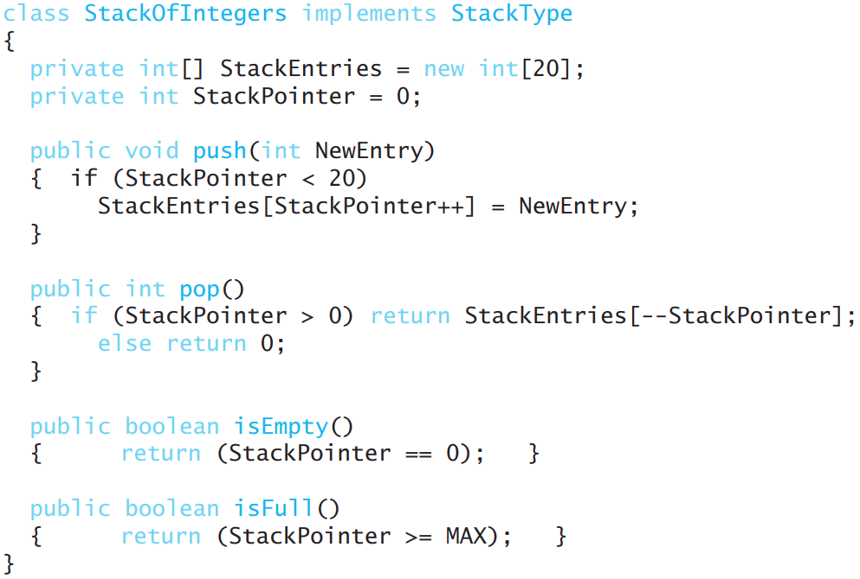
Classes and Objects
A stack of integers implemented in Java and C#
Notes:
In many respects, these classes are actually descriptions of abstract data types (whose instances are called objects).
For example, Figure 8.27 shows how a class known as StackOfIntegers can be defined in the languages Java and C#.
Note that this class provides a body for each of the functions declared in the abstract data type StackType.
In addition, this class contains an array of integers called StackEntries, and an integer used to identify the top of the stack within the array called StackPointer.
Using this class as a template, an object named StackOne can be created in a Java or C# program by the statement
StackType StackOne = new StackOfIntegers();
or in a C++ program by the statement
StackOfIntegers StackOne();
Later in the programs, the value 106 can be pushed onto StackOne using the statement
StackOne.push(106);
or the top entry from StackOne can be retrieved and placed in the variable OldValue using the statement
OldValue = StackOne.pop();

Slide 56
Classes and Objects
Abstract Data Type | Objects
Abstract data type is abstraction that define set of values and set of operations on these values. | It is a self-contained component which consists of methods and properties to make certain type of data useful.
User-defined data type. | It is an instance of class.
ADT is made of with primitive datatypes. | An object is an abstract data type with the addition of polymorphism and inheritance.
It is a type (or class) for objects whose behaviour is defined by a set of value and a set of operations. | It is a basic unit of Object-Oriented Programming.
Is not necessarily an OOP concept. | Objects is an OOP concept.
Common examples include lists, stacks, sets, etc. | Objects have states and behaviours Test t = new Test();.
Allocate memory when data is stored. | When we instantiate an object then memory is allocated.
Notes:
These features are essentially the same as those associated with abstract data types. There are, however, distinctions between classes and abstract data
types. The former is an extension of the latter. For instance, as we learned in
Section 6.5, object-oriented languages allow classes to inherit properties from
other classes and to contain special methods called constructors that customize
individual objects when they are created. Moreover, classes can be associated
with varying degrees of encapsulation (Section 6.5), allowing the internal properties of their instances to be protected from misguided shortcuts, while exposing
other fields to be available externally.
We conclude that the concepts of classes and objects represent another step
in the evolution of techniques for representing data abstractions in programs. It
is, in fact, the ability to define and use abstractions in a convenient manner that
has led to the popularity of the object-oriented programming paradigm.

Slide 57

Extra Reading
Brookshear JG, Smith D, Brylow D.
“Computer science: an overview”.
Read the following section in the textbook.
Chapter: 8.7. Pointers in Machine Language
Summarize the section in 1 page (no figure should be included.)
Template for summarization assignments:
https://docs.google.com/document/d/1i1tU3AdIvPgRxqzGmXrsnVVCRXws5V3caDTCPMbPJ_0/edit?usp=sharing

Slide 58
Research Themes
Hash-based data structures
Graphs
Self balancing binary trees
Probabilistic data structures

Slide 59
COM1013
INTRODUCTION TO COMPUTER SCIENCE
Lecturer: Begüm MUTLU BİLGE, PhD
begummutlubilge+com1013@gmail.com (recommended)
bmbilge@ankara.edu.tr

